Slide 1
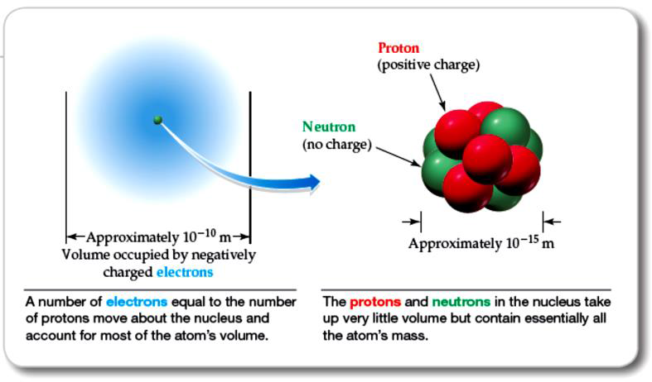
Figure (2) A view of the atom

Slide 2
Figure (3) A hydrogen, carbon and gold atoms with an explanation of the atomic and mass number

Slide 3
Figure 4Schematic representation of an element symbol with its mass and atomic number
One of the early attempt that described electron in atoms is a Bohr model, which explain the atom in terms of position (electron orbit) and energy (quantized energy levels), as shown in Figure 5.

Slide 4
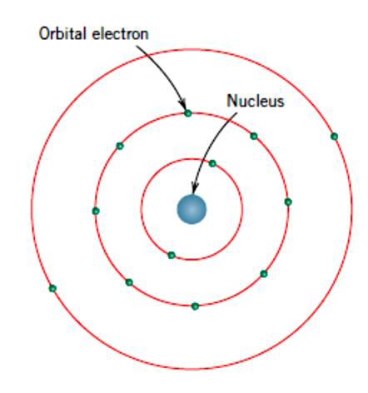
Figure (5) Schematic of the Bohr atom

Slide 5
2.2 Atomic Bonding in Solids
It has been established that there are three types of primary or chemical bonds are found in solids; which are ionic, covalent, and metallic bond. On the other hand, there are also found secondary or called physical forces in many solid material, which are weaker than the primary ones, but however influence the physical properties of some materials. These bonds are described below in this section.

Slide 6
Ionic bond is the easiest to describe and visualize. It is normally found in compounds that are consist of both metallic and nonmetallic elements. Atoms of a metallic element easily give up their valence electrons to the nonmetallic atoms. Sodium chloride (NaCl) is the classic ionic material. A sodium atom can assume the electron structure of neon (and a net single positive charge) by a transfer of its one valence 3s electron to a chlorine atom. After such a transfer, the chlorine ion has a net negative charge and an electron configuration identical to that of argon. In sodium chloride, all the sodium and chlorine exist as ions. This bond is shown schematically in Figure 6. The ionic bond is considered as a stronger bond between atoms and their properties are brittleness and low electrical conductivity

Slide 7
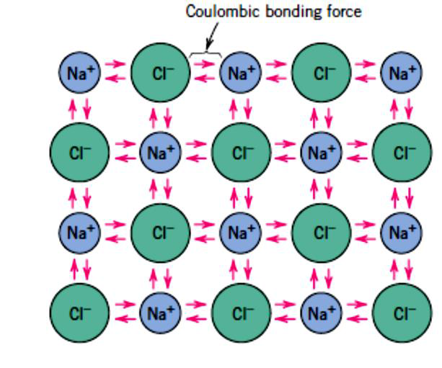
Figure (6) Schematic of the ionic bond in sodium chloride

Slide 8
Covalent bond, in this type of bond stable electron configurations are assumed by the sharing of electrons between adjacent atoms. Two atoms that are covalently bonded will each contribute at least one electron to the bond, and the shared electrons may be considered to belong to both atoms, this bond is shown in Figure 7 for a molecule of methane. The carbon atom has four valence electrons, whereas each of the four hydrogen atoms has a single valence electron. The carbon now has four additional shared electrons, one from each hydrogen, for a total of eight valence electrons. The covalent bond is directional; that is, it is between specific atoms and may exist only in the direction between one atom and another that participates in the electron sharing.

Slide 9
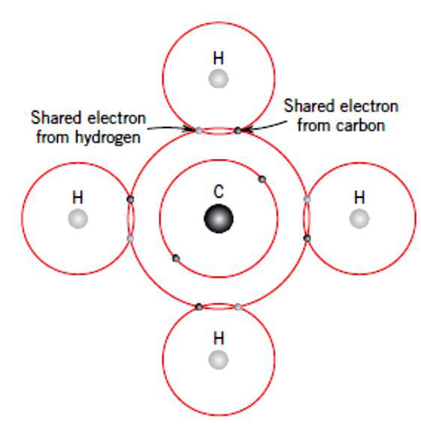
Figure (7) Illustrate covalent bond in a molecule of methane (CH4)

